Slide 1
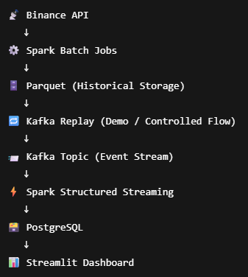
Real-Time Crypto Market Data Pipeline

Slide 2
